Slide 1

Social Science Research Design and Statistics, 2/e
Alfred P. Rovai, Jason D. Baker, and Michael K. Ponton
Wilcoxon Matched-Pair Signed Ranks Test
PowerPoint Prepared by
Alfred P. Rovai
IBM® SPSS® Screen Prints Courtesy of International Business Machines Corporation,
© International Business Machines Corporation.

Slide 2
Uses of the Wilcoxon Matched-Pair Signed Ranks Test
The Wilcoxon matched-pair signed ranks test (also called the Wilcoxon matched pairs test or the Wilcoxon signed ranks test) is a nonparametric procedure that compares differences between data pairs of data from two dependent samples.
It is similar to the related samples sign test except that this test factors in the size as well as the sign of the paired differences.
This procedure involves ranking all nonzero difference scores disregarding sign, reattaching the sign to the rank, and then evaluating the mean of the positive and the mean of the negative ranks. Consequently, the Wilcoxon matched-pair signed ranks test is more powerful than the related sample sign test and is the preferred test.

Slide 3
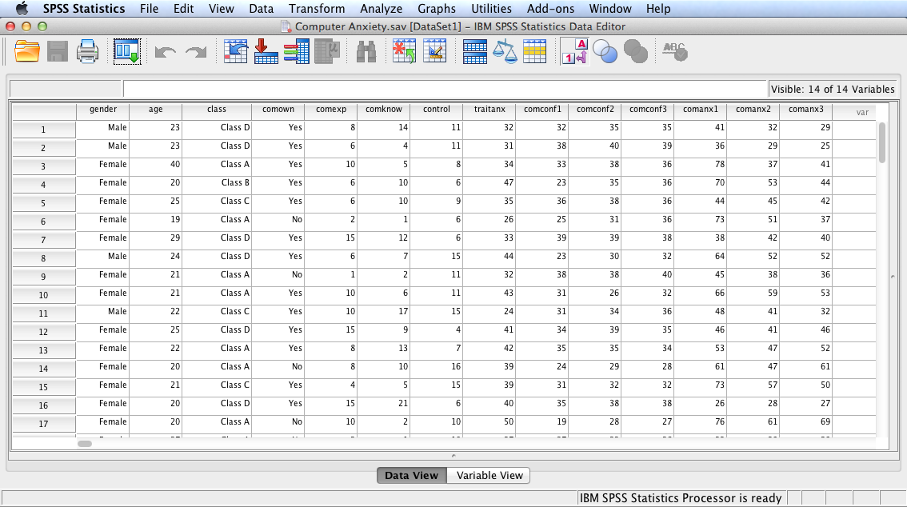
Open the dataset Computer Anxiety.sav.
File available at http://www.watertreepress.com/stats

Slide 4
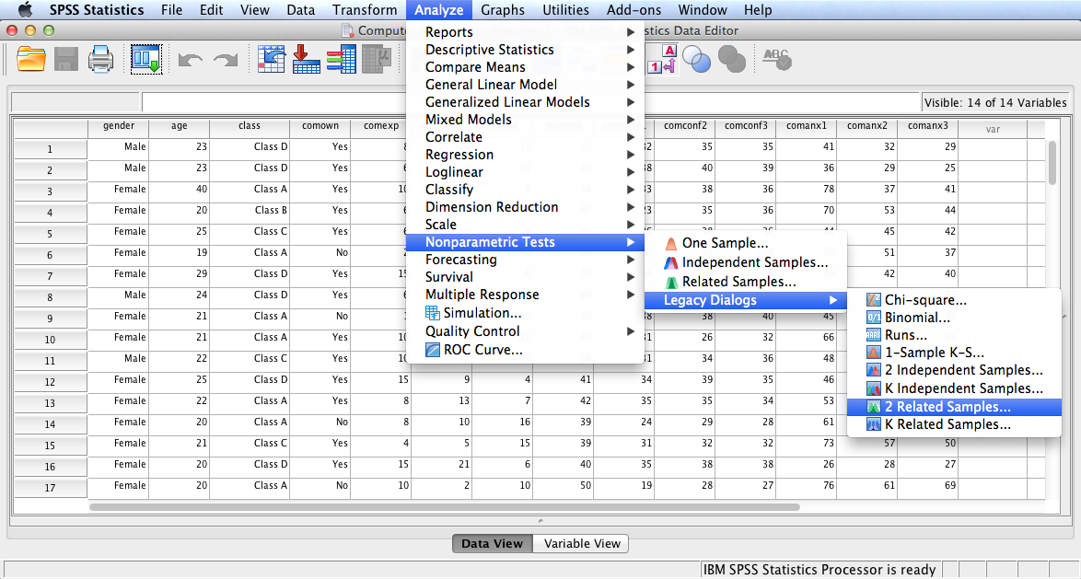
Follow the menu as indicated to conduct the Wilcoxon test using Legacy Dialogs. Alternatively, one can run the test using the Related Samples option under the Nonparametric Tests menu.

Slide 5
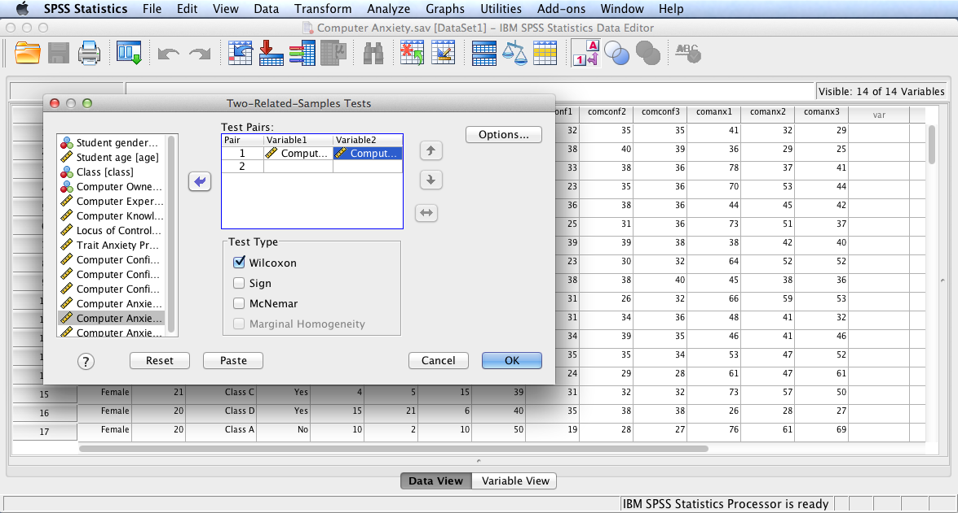
In this example, we will test the following null hypothesis:
H_{o}: There is no difference in ranks between computer anxiety pretest and computer anxiety posttest among university students.
Move Computer Anxiety Pretest and Computer Anxiety Posttest to the Test Pairs: box. Check Wilcoxon as the Test Type. Click Options.

Slide 6
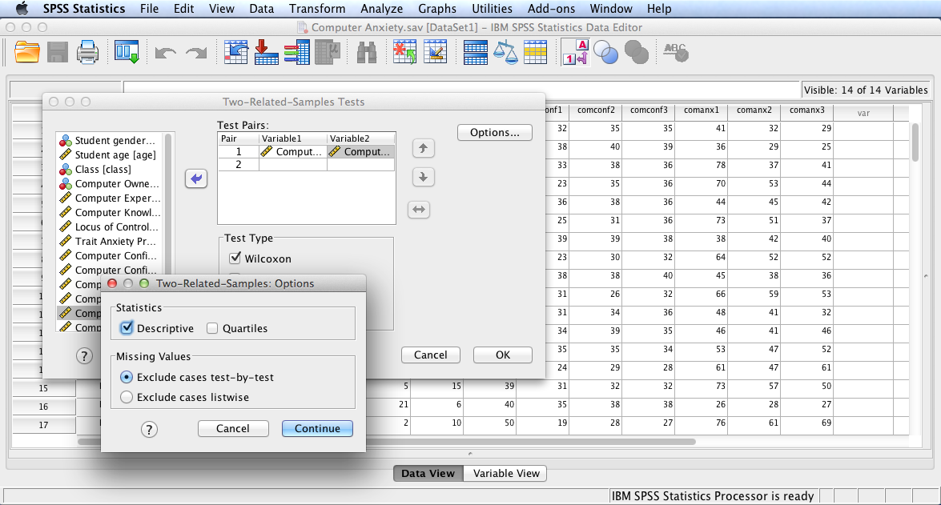
Check Descriptive to generate descriptive statistics output. Click Continue and then OK to run the test.

Slide 7
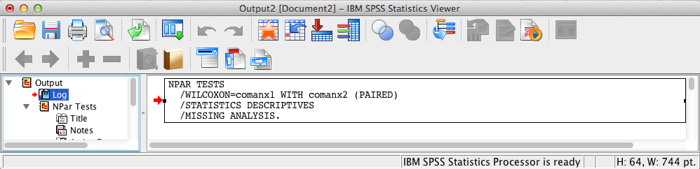
SPSS Output
The contents of the SPSS Log is the first output entry. The Log reflects the syntax used by SPSS to generate the Npar Tests output.

Slide 8
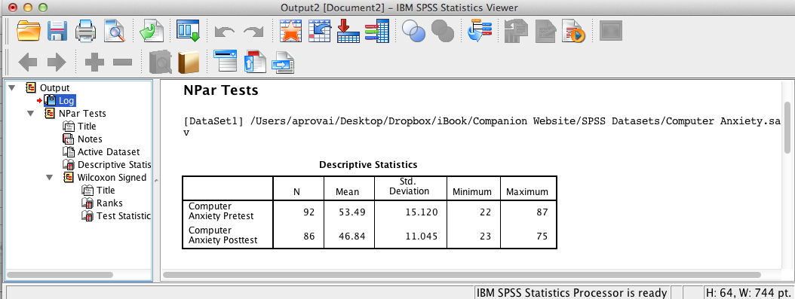
SPSS Output
The above SPSS output displays descriptive statistics.

Slide 9
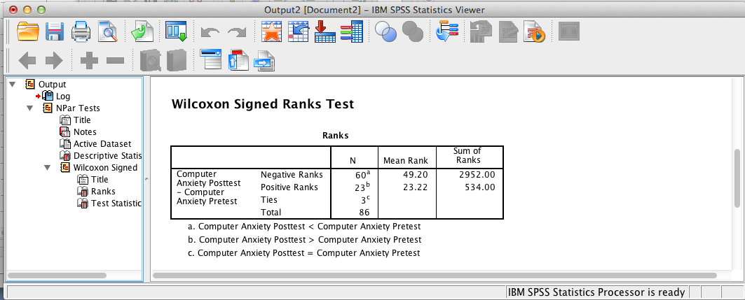
SPSS Output
The above SPSS output displays ranks statistics. It shows the mean of the ranks of the difference scores in which posttest computer anxiety decreased is 49.20 and the mean of the ranks of the difference scores in which posttest computer anxiety increased is 23.22.

Slide 10
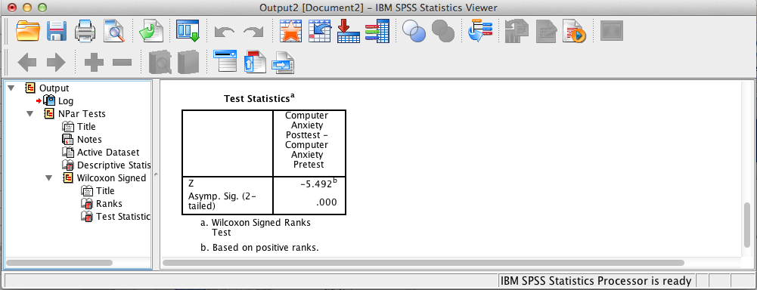
SPSS Output
The above SPSS output shows that the test is significant using the z-approximation since the significance level <= .05 (the assumed à priori significance level).
Note: report the p-value as p < .001. SPSS truncates values; the SPSS output does not mean that the p-value is zero.

Slide 11
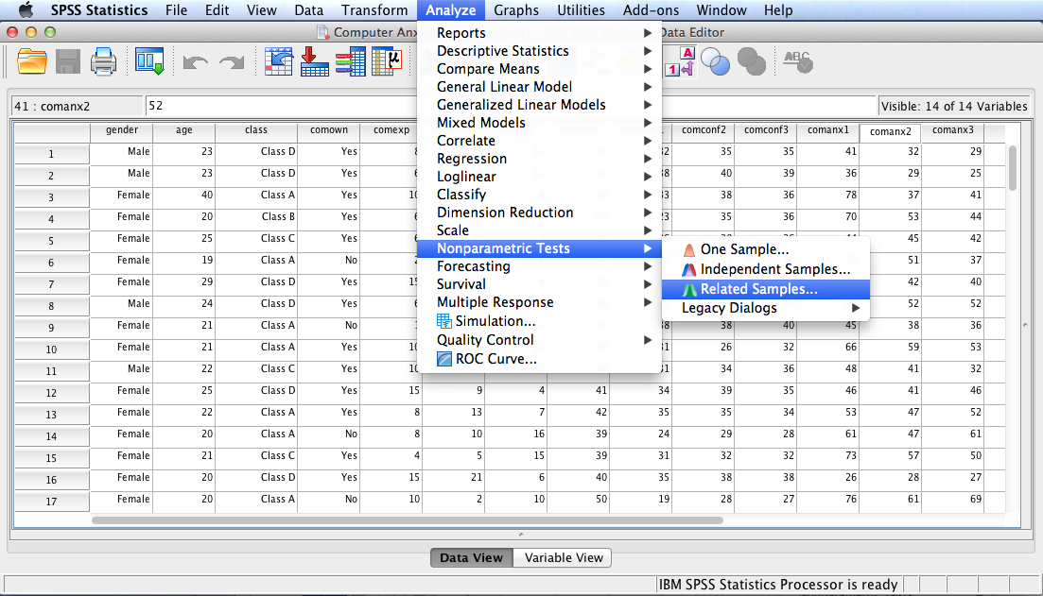
Follow the menu as indicated to conduct the Wilcoxon test using the Related Samples option in the Nonparametric Tests menu.

Slide 12
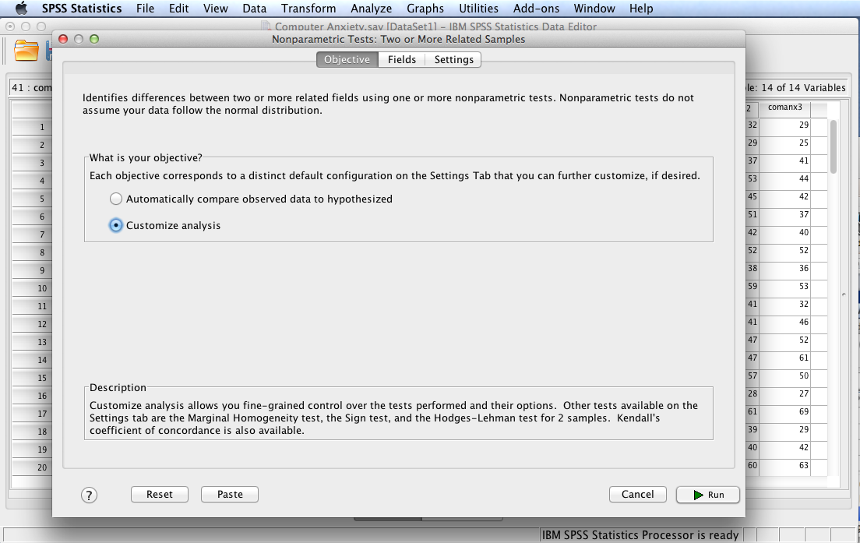
Select Customize analysis and then click the Fields tab.

Slide 13
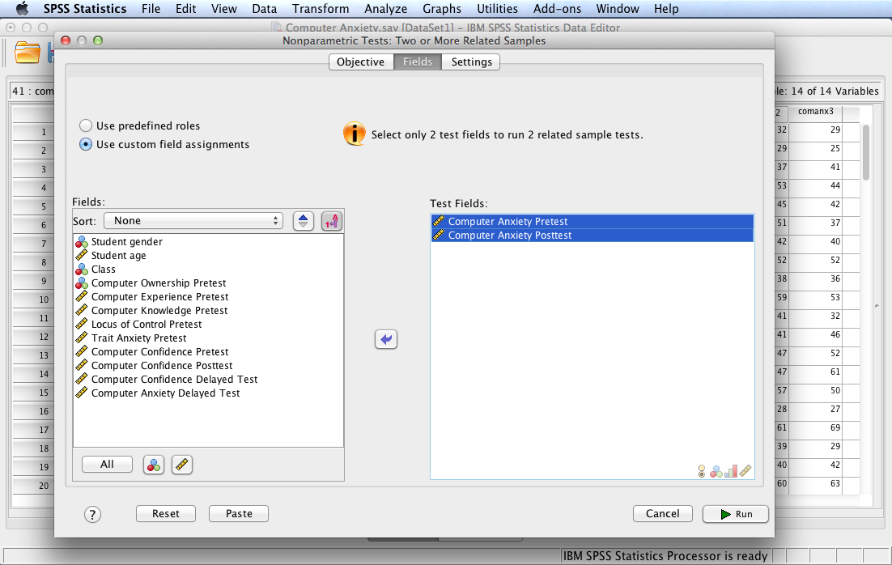
Move Computer Anxiety Pretest and Computer Anxiety Posttest to the Test Fields: box. Click the Settings tab.

Slide 14
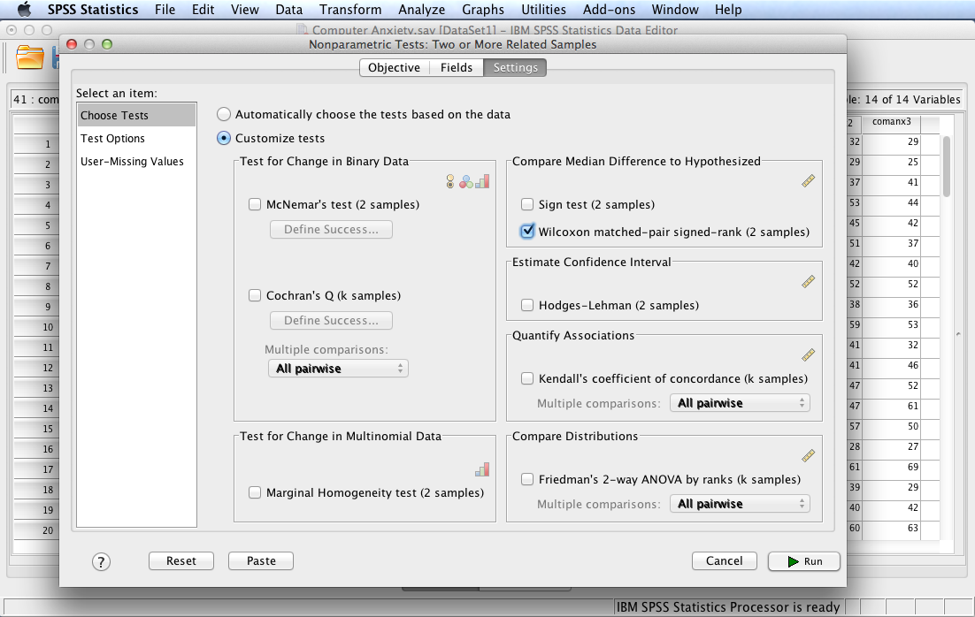
Select Wilcoxon matched-pair signed rank (2 samples) box then select Test Options in the Select an item: box.

Slide 15
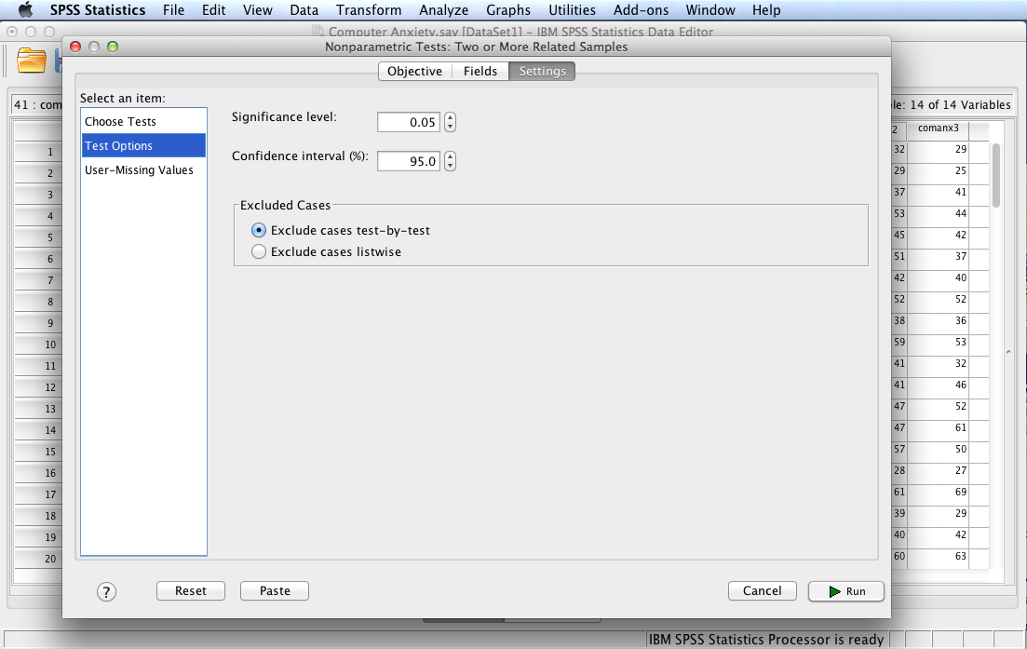
Note and accept the default settings by clicking Run to run the test.

Slide 16
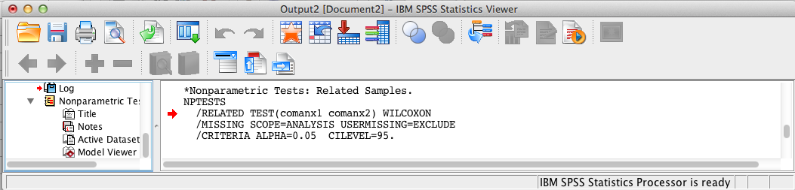
SPSS Output
The contents of the SPSS Log is the first output entry. The Log reflects the syntax used by SPSS to generate the Nonparametric Tests output.

Slide 17
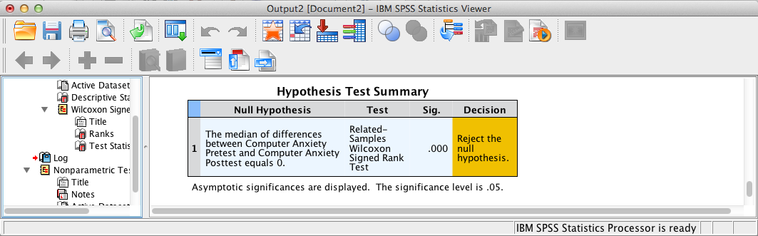
SPSS Output
Test summary statistics are provided above. Double-click the table in the SPSS output to display details in the Model Viewer.

Slide 18
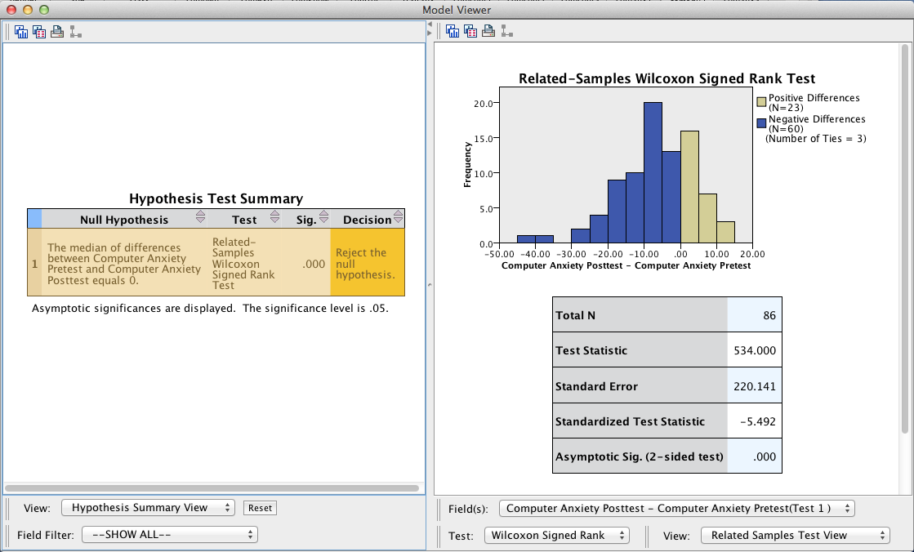
SPSS Output
Additional test output is provided by the Model Viewer.

Slide 19
Wilcoxon Matched-Pair Signed Ranks Test Results Summary
H₀: There is no difference between the distribution of sense of classroom community data and a normal distribution. Test results are significant using the z-approximation, z = 5.49, p < .001, indicating a significant decrease in ranks between computer anxiety pretest and computer anxiety posttest among university students. Effect size using the r-approximation is .59, suggesting a moderate effect size.
Note: when reporting z one may ignore the negative sign provided the direction of difference is noted in the results. Effect size is calculated using the following formula: r = z/√N = 5.49/√86 = 5.49/9.27 = 59.

Slide 20
End of Presentation

